Slide 1
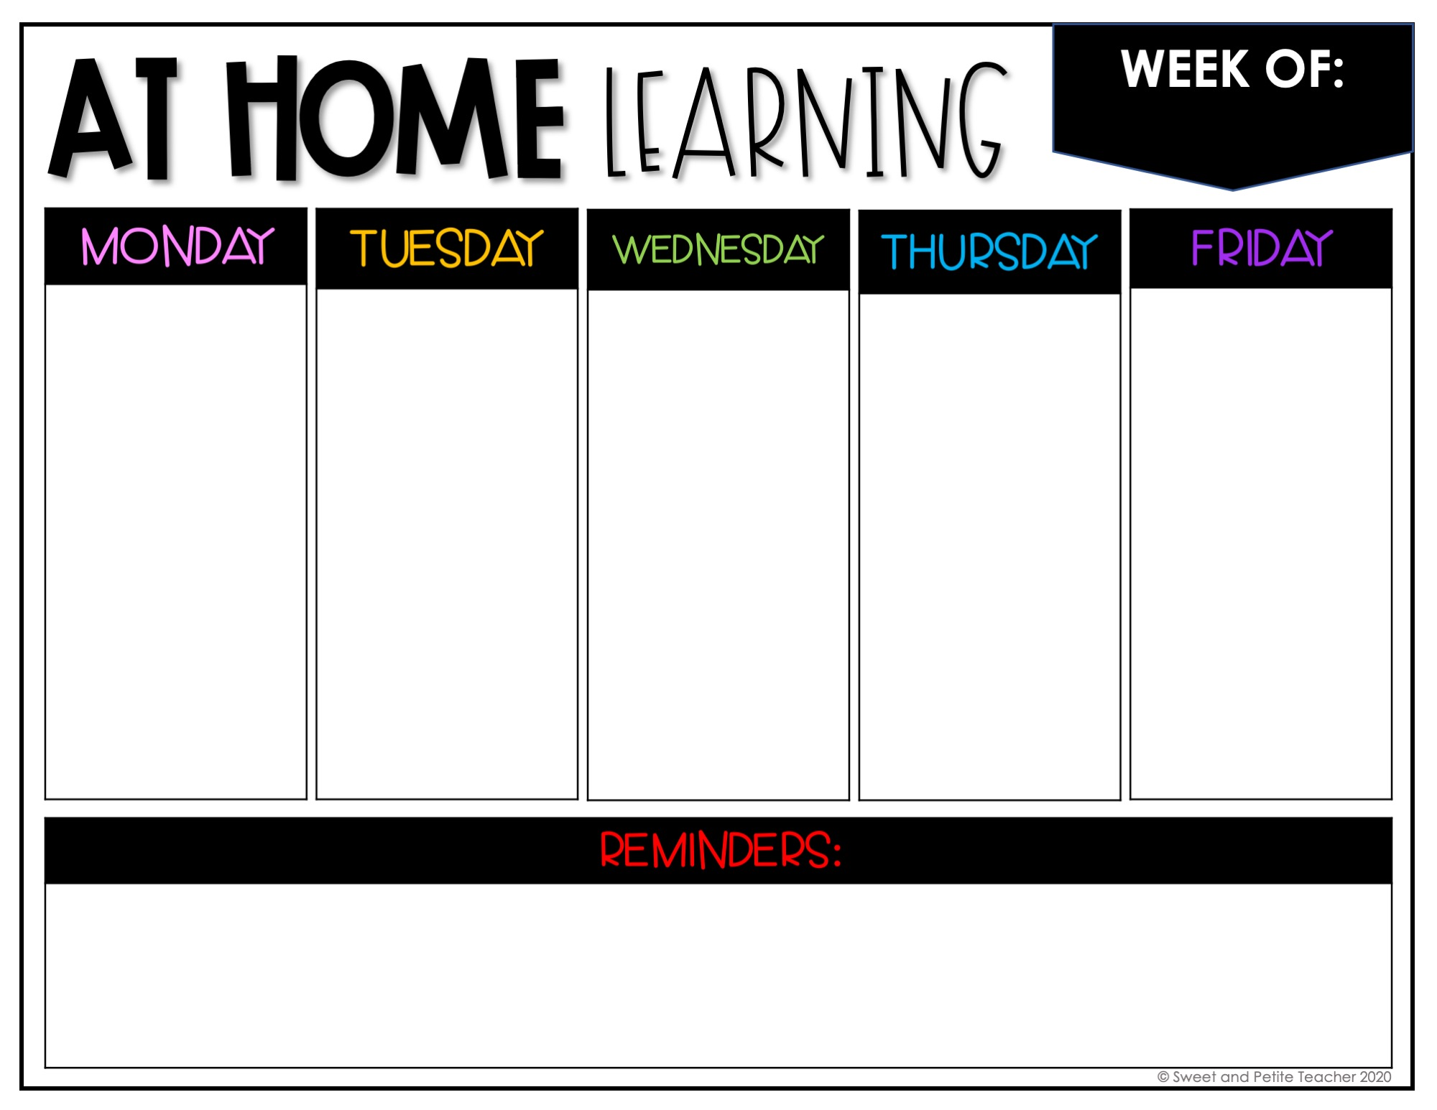
8/24-8/28
8/24 LIVE
8/25 INDEPENDENT
8/26 LIVE
8/27 INDEPENDENT
8/28 INDEPENDENT
Check-in
Welcome
About me one pager
Check-in
Succession
Ordering Activity on Google Forms
Check-in
Dichotomous keys Activity
Answers from Activity on Google Form
Check-in
Bellringer
Biodiversity
Short Answer from reading
Check-in
Bellringer
Energy Pyramids
Turn in Syllabus
Office Hours: 2:10-3:00
Office Hours: 2:10-3:00
Office Hours: 2:10-3:00
Office Hours: 2:10-3:00
Office Hours: 2:10-3:00
All M/W Live sessions will be on Google Meets
T/TH/F Live Q&A first 15 min of each class on Google Meets
Make sure to check in DAILY
Make sure to attach completed documents when you are ready to turn in

Slide 2
8/31-9/4
8/31 LIVE
9/1 INDEPENDENT
9/2 LIVE
9/3 INDEPENDENT
9/4 INDEPENDENT
Check-in
Bellringer
Relationships in Food Webs
Check-in
Bellringer
Food Web Project Day 1
Check-in
Bellringer
Food Web Project Day 2
Check-in
Bellringer
Food Web Project Day 3
Check-in
Bellringer
Ecology 1 Test
Office Hours: 2:10-3:00
Office Hours: 2:10-3:00
Office Hours: 2:10-3:00
Office Hours: 2:10-3:00
Office Hours: 2:10-3:00
All M/W Live sessions will be on Google Meets
T/TH/F Live Q&A first 15 min of each class on Google Meets
Make sure to check in DAILY
Make sure to attach completed documents when you are ready to turn in

Slide 3
9/7-9/11
9/7
9/8 INDEPENDENT
9/9 LIVE
9/10 INDEPENDENT
9/11 INDEPENDENT
NO SCHOOL
Check-in
Bellringer
Human Dependence on Ocean Systems
Check-in
Bellringer
Dead Zone Day 1
Check-in
Bellringer
Dead Zone Day 2
Check-in
Bellringer
Chernobyl Video/Notes
Office Hours: 2:10-3:00
Office Hours: 2:10-3:00
Office Hours: 2:10-3:00
Office Hours: 2:10-3:00
Office Hours: 2:10-3:00
All M/W Live sessions will be on Google Meets
T/TH/F Live Q&A first 15 min of each class on Google Meets
Make sure to check in DAILY
Make sure to attach completed documents when you are ready to turn in

Slide 4
9/14-9/18
9/14 LIVE
9/15 INDEPENDENT
9/16 LIVE
9/17 INDEPENDENT
9/18 INDEPENDENT
Check-in
Bellringer
Check-in
Bellringer
Check-in
Bellringer
Check-in
Bellringer
Check-in
Bellringer
Office Hours: 2:19-3:15
Office Hours: 2:19-3:15
Office Hours: 2:19-3:15
Office Hours: 2:19-3:15
Office Hours: 2:19-3:15
All M/W Live sessions will be on Google Meets
T/TH/F Live Q&A first 15 min of each class on Google Meets
Make sure to check in DAILY
Make sure to attach completed documents when you are ready to turn in

